Slide 1


Developing E-learning Mobile Application with Flutter
GRADUATION THESIS
Student: | Tran Duc Phung
Supervisor: | Ph.D Nguyen Thanh Hung
Notes:
Hello everyone, I’m Trần Đức Phụng, I’m a student of Global ICT program.
Today, I will present about my graduation thesis “Developing E-learning Mobile Application with Flutter”

Slide 2
OUTLINE
01
Problem Description
04
02
Main Contributions
Solution Approach
03
05
System Design and Development
Future Work
Notes:
My presentation have five sections including Problem Description, Solution Approach, System Design and Development, Main contributions
And the last section is about Future work

Slide 3
01
Problem Description
Notes:
So now, let me describe the problem that my graduation thesis aims to address

Slide 4

E-learning Today
Demand on online learning
Most of universities & educational centers now allows students to study online
E-learning
Is
So Essential
Notes:
- In recent years, E-learning has gradually become an indispensable part of education.
- Conducting courses online not only makes it easier to manage classes but also helps to reduce many of the costs associated with renting space. - Besides, this also helps students save time and travel costs.
- Especially in the context of the Covid-19 pandemic, Elearning has proven its pivotal role even more. With social distancing and not taking offline classes, online learning is the only way for students to continue attending classes and acquiring knowledge.
- In addition, it’s quite hard to upload lectures to some elearning platform as Udemy or Coursera. You must to register as a partner to do that. And its requires lots of difficult steps. Moreover, Having your own system also give you the ability to customize and manage the user data.
---> For the above reason, the thesis aims to build a mobile application providing users a place to study and practice online

Slide 5

02
Solution Approach
Notes:
Let move on to the next section , where I will describe my solution approach to solve this problem

Slide 6
Platform
Mobile application
Learn anywhere, at any time
Utilize multi-platform
Notes:
The reason i choose mobile platform is that mobile is now very common, almost everyone has at least 1 smart phone
With internet connection, we can learn anywhere, at any time
However, the truth is that the two most popular operating systems for phones today, Android and iOS, require different programming. Designing a separate application program for each operating system will take much effort, requiring human resources, time, and money. Therefore I decide to use Flutter to build both Android and iOS program with only a single code base. Which helps save lots of effort and time to develop and maintain.

Slide 7

Features
User
Take lesson
Do exercise
Do test
Discuss & Feedback
Notes:
- The application will have all the essential features about Learning
The first one is Taking a lesson
After taking a lesson, learner can do the exercise and test
In addition, they can also discuss and give feedbacks about any course

Slide 8







Technology
Frontend
Backend
Version control & Module management
Git & Git Submodule
Material Design
Notes:
About the technology
I am using Dart, Flutter and utilize material design as component standard to build mobile user interface
For backend, almost my services written in NodeJs & ExpressJs
I also have use firebase to store images and comments of users.
And in order to persist the data, I choose mongo
For the version control and managing modules of the app, git and git submodule is the most suitable and convenient

Slide 9

03
System Design and Development
Notes:
The next section of my presentation is about System Design and Development
In this section, I will talk about the process of developing and designing my application

Slide 10
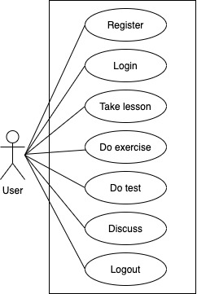
Use case Diagram
General use case
Notes:
So first, let’s start with the general usecase diagram of my application
As you can see, the main actor is user. Users need to register and login before using any other functionalities.
There are 4 main use case corresponding to 4 features in this application: Take lesson, Do exercise, Do test, and Discuss

Slide 11
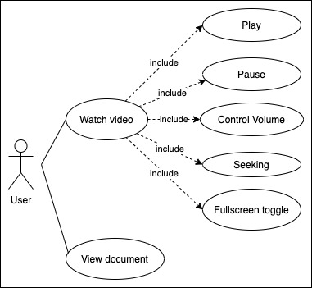
Use case Diagram
Take lesson use case
Notes:
For the first use case, User can watch the video, control the playback, and View the document.

Slide 12
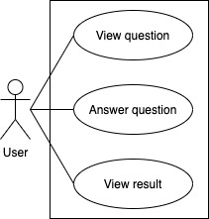
Use case Diagram
Do Exercise use case
Notes:
For the second use case. User can view the question, answer it and view the result.

Slide 13
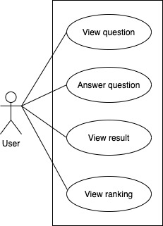
Use case Diagram
Do Test use case
Notes:
The Do Test use case is similar to the Do Exercise, and Users can view the ranking after doing the test.

Slide 14
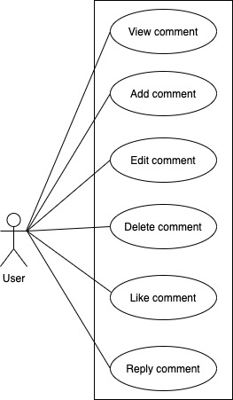
Use case Diagram
Discuss use case
Notes:
For the discussion use case, user have lots of actions such as: view, create, edit, edit, delete, like, and reply

Slide 15
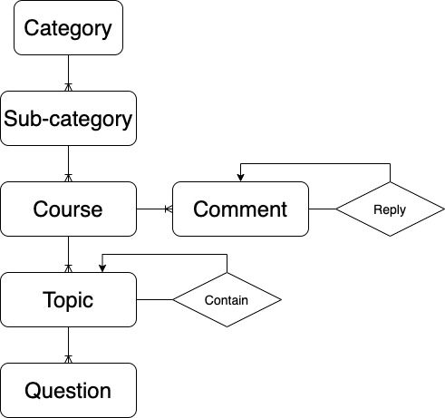
Conceptual data model

Slide 16
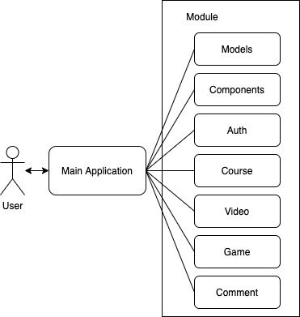
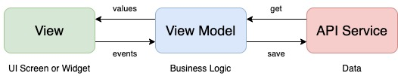
System Architecture
Module’s architecture

Slide 17
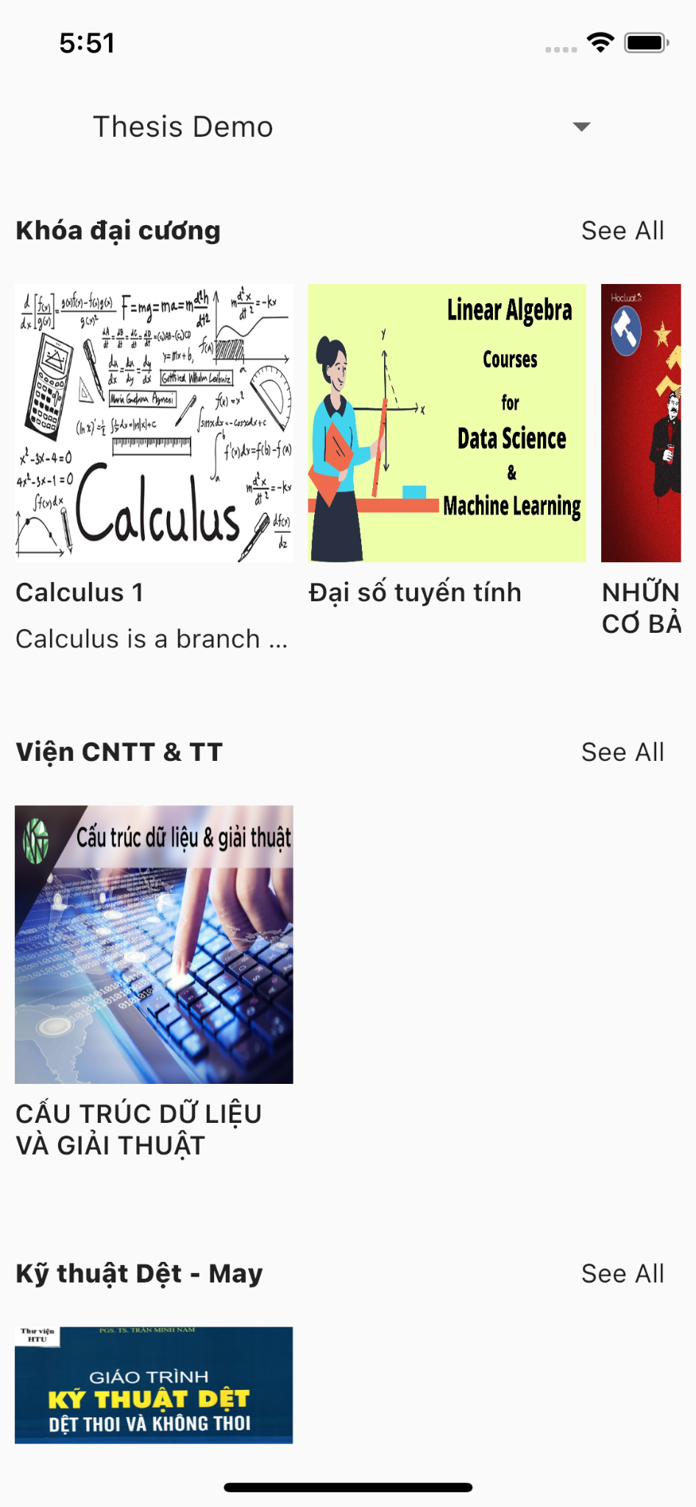
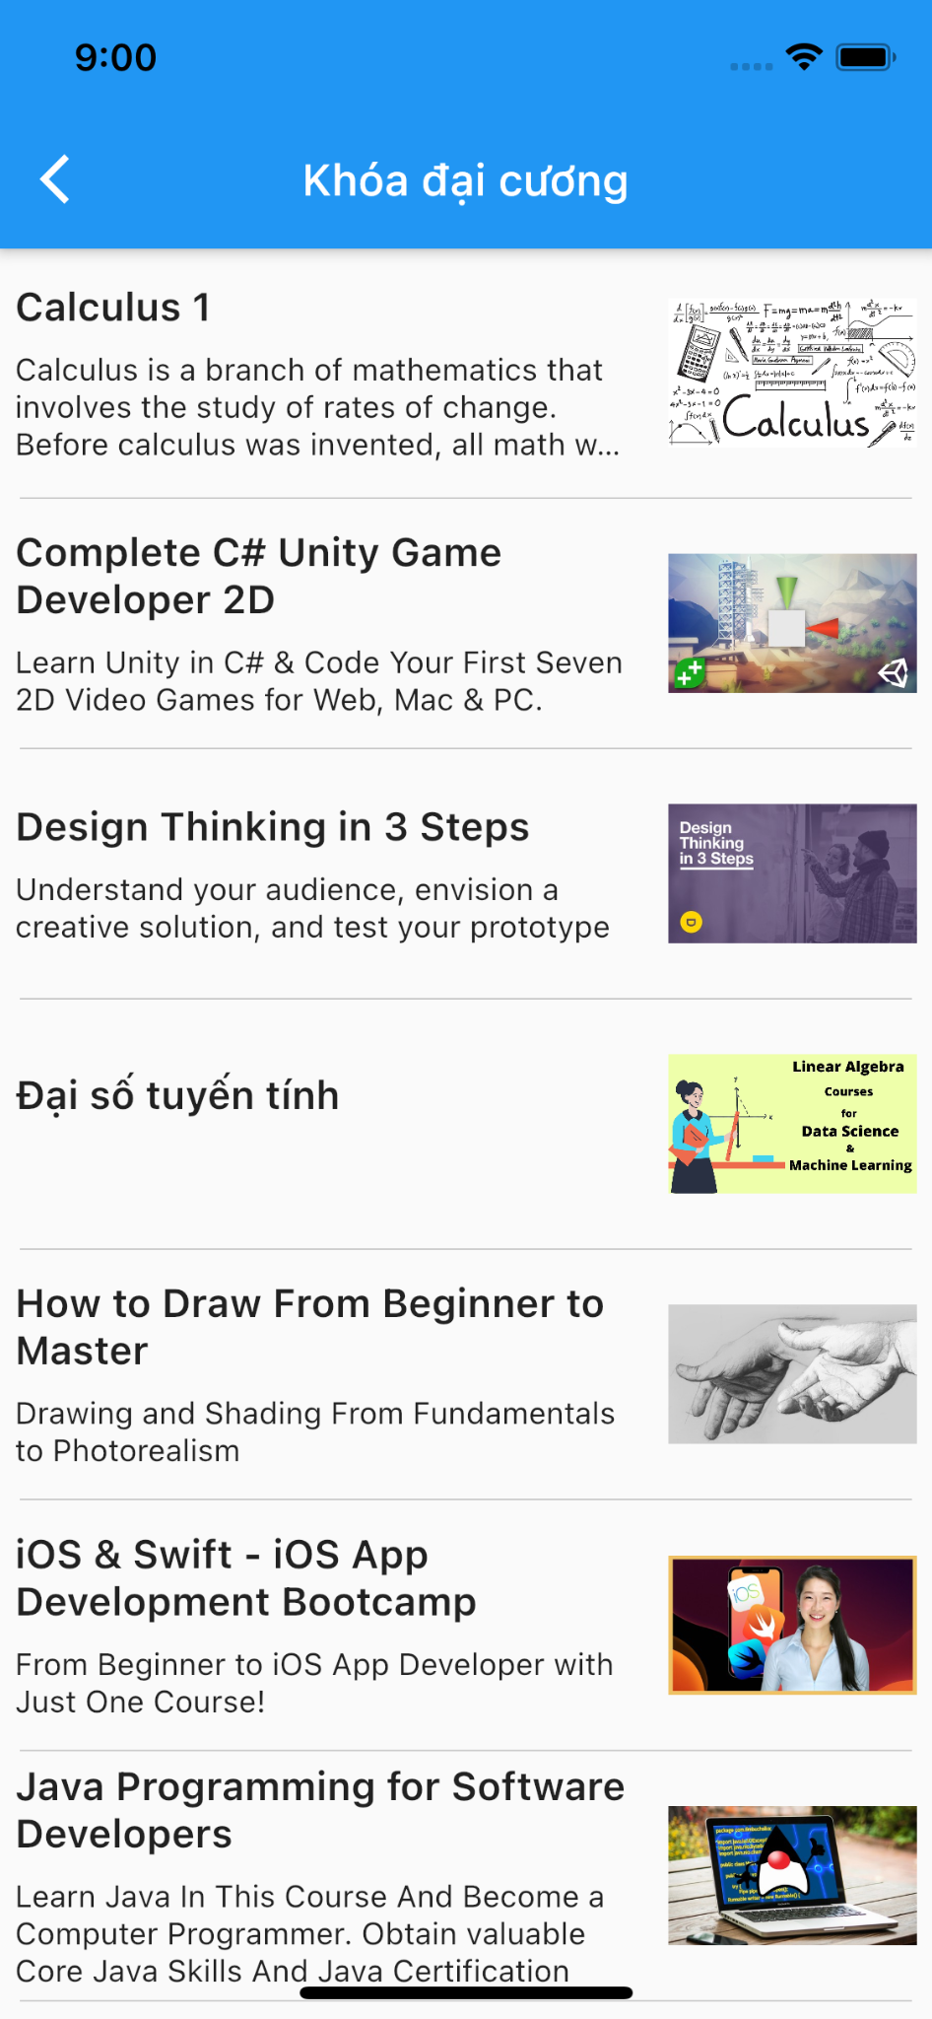
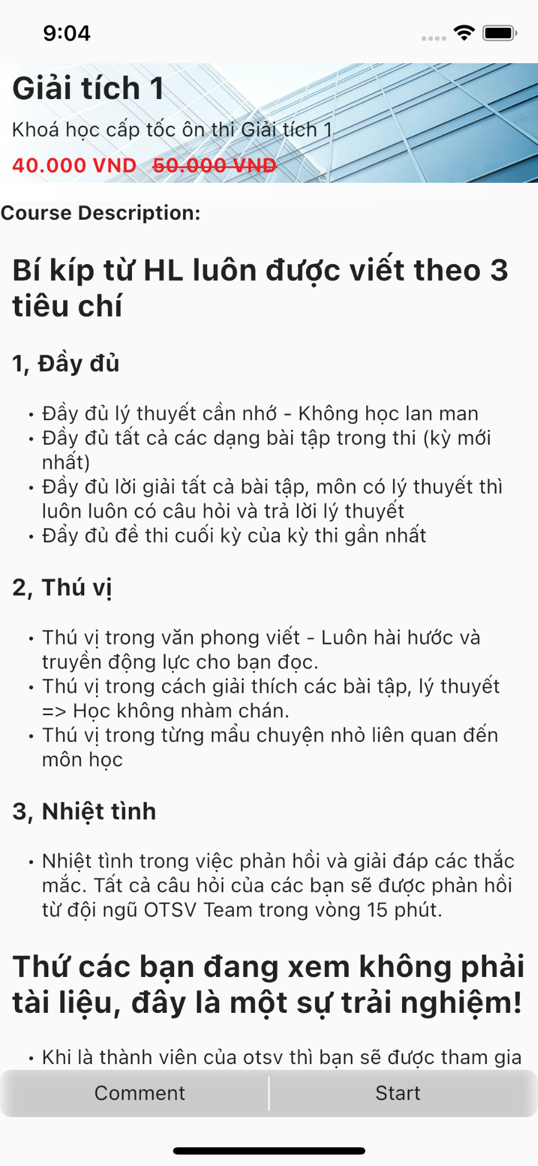
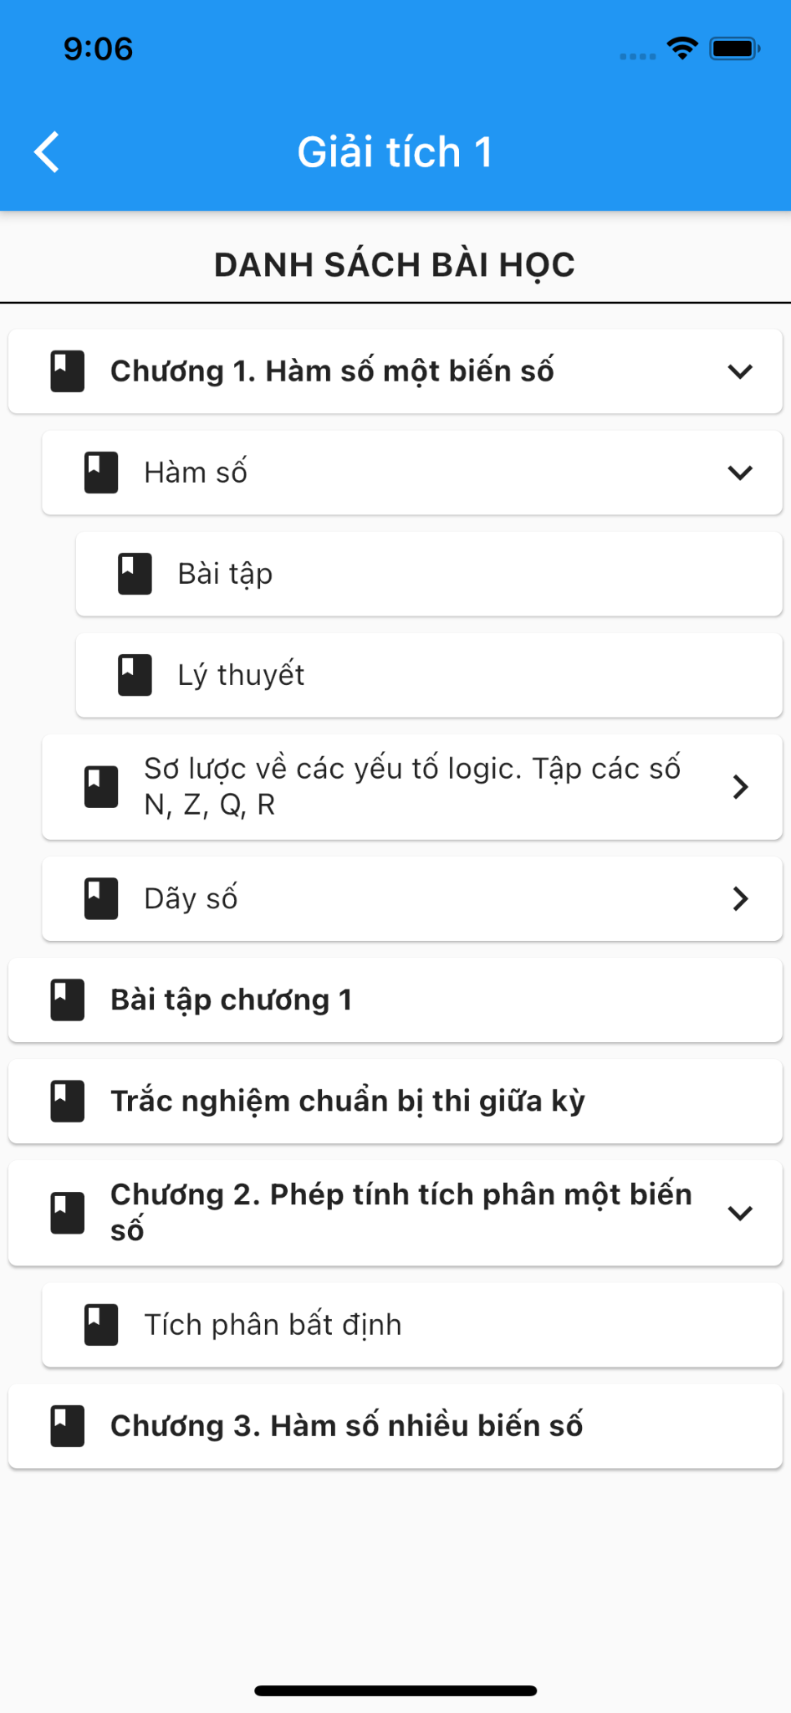
Achievements

Slide 18
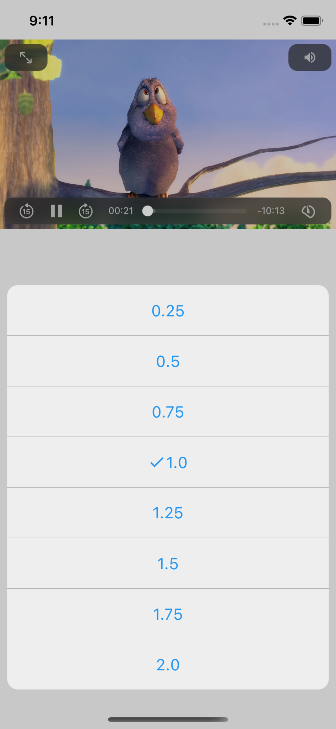
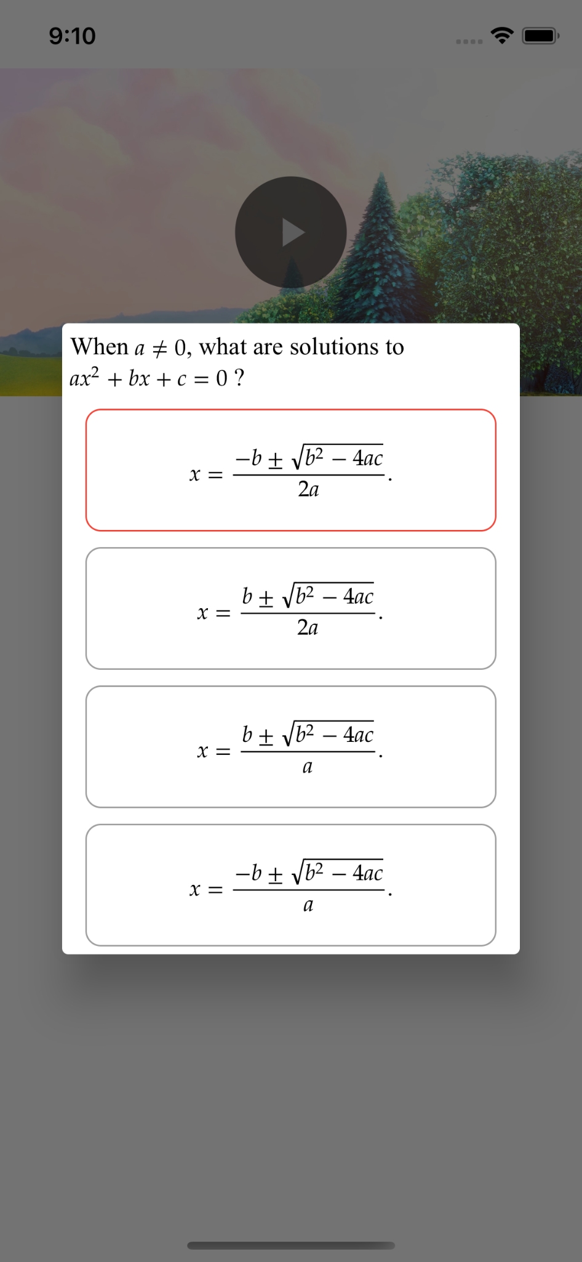
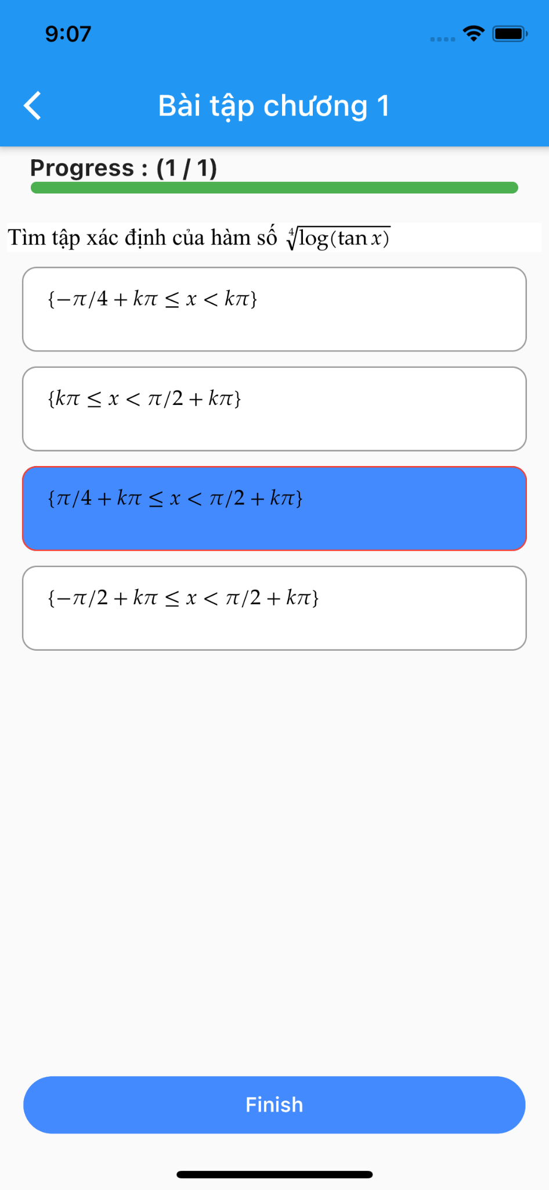
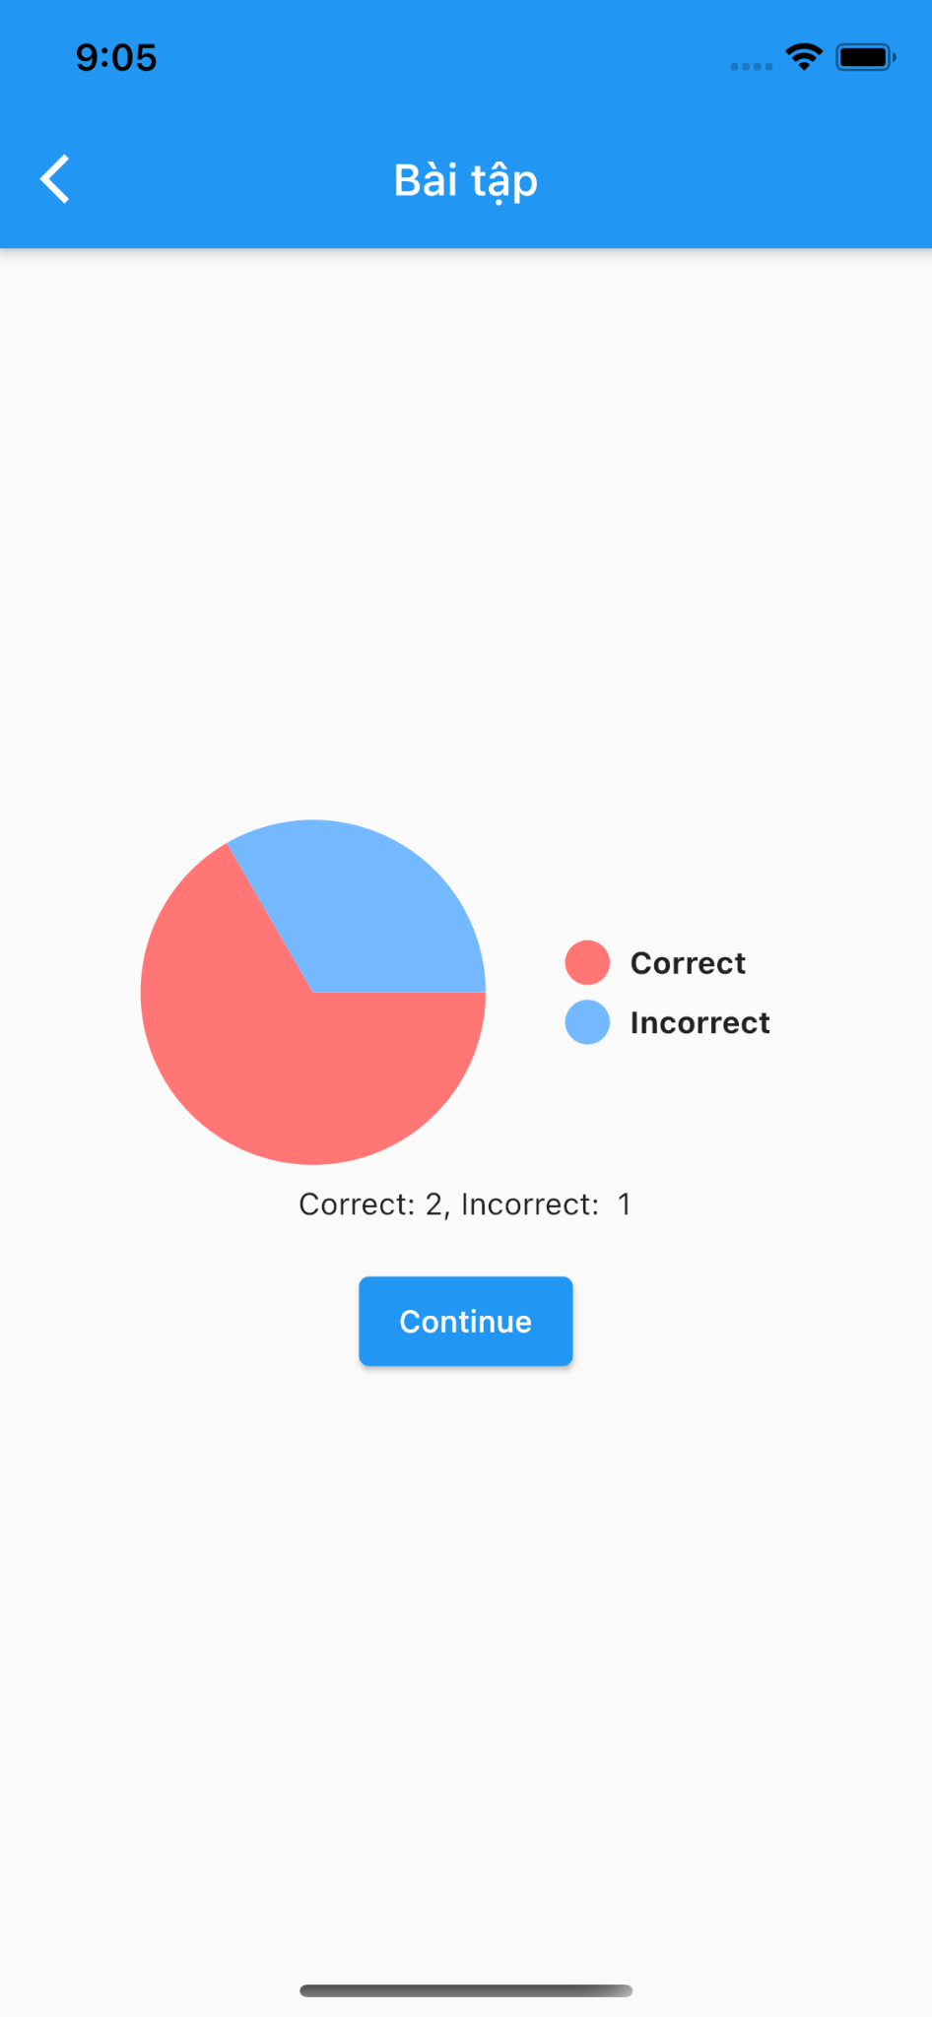
Achievements

Slide 19
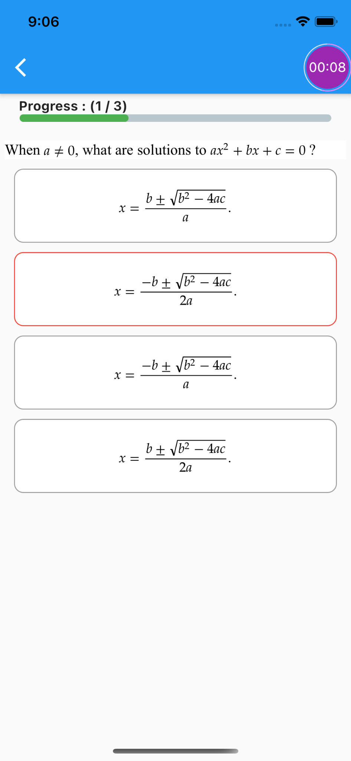
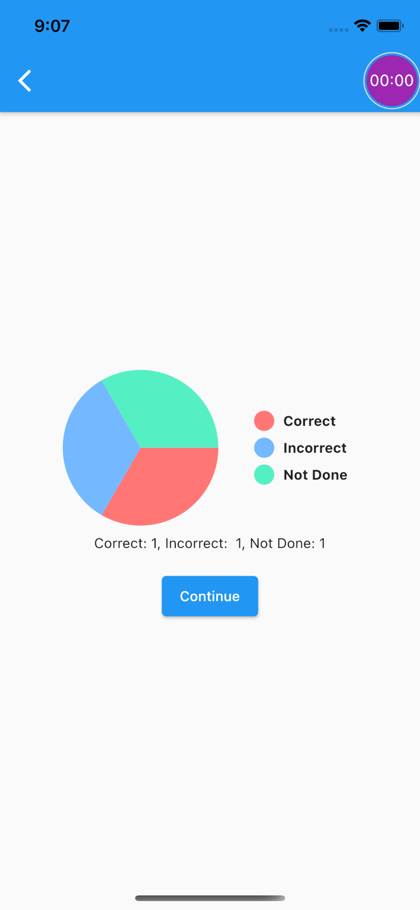
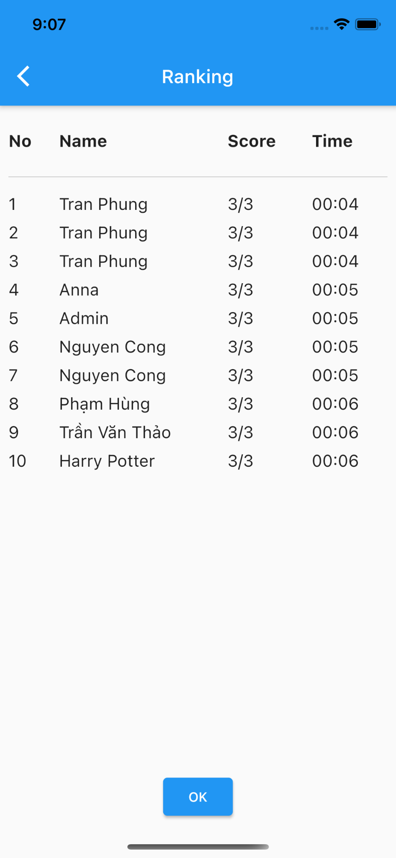
Achievements

Slide 20
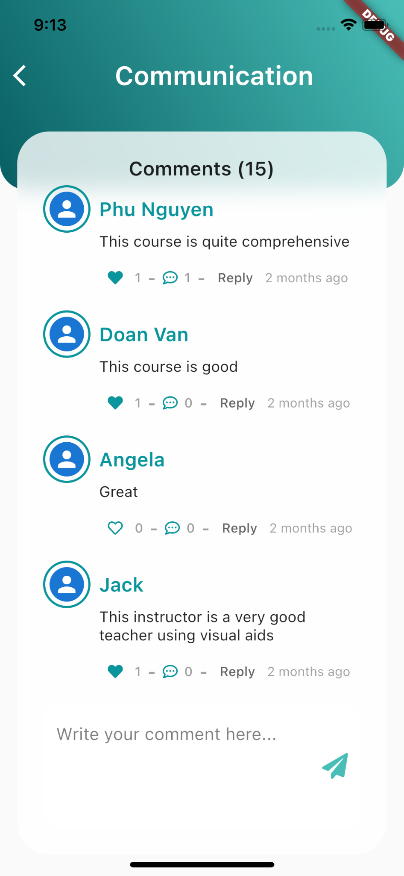
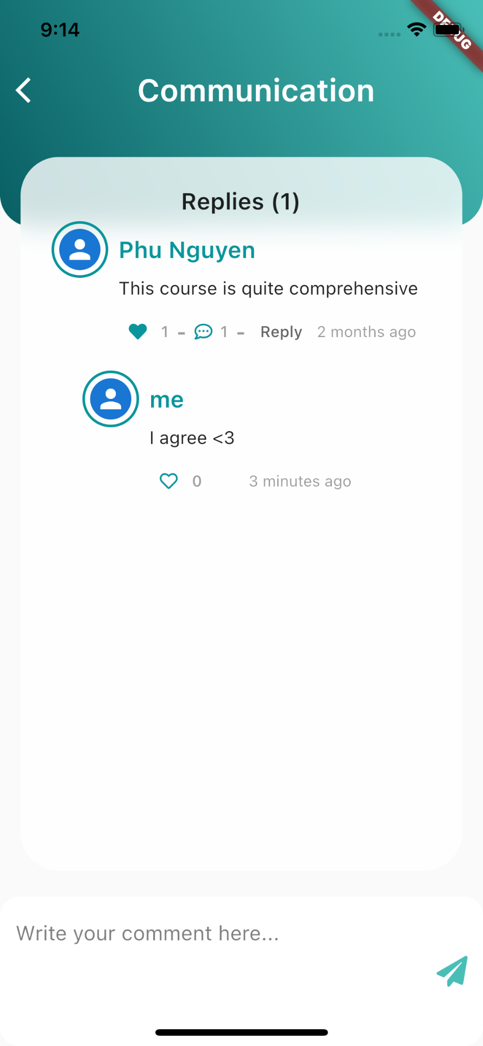
Achievements

Slide 21

04
Main Contributions
Notes:
So That all about, system design and development, let move on the fourth section . It’s about my main contributions

Slide 22
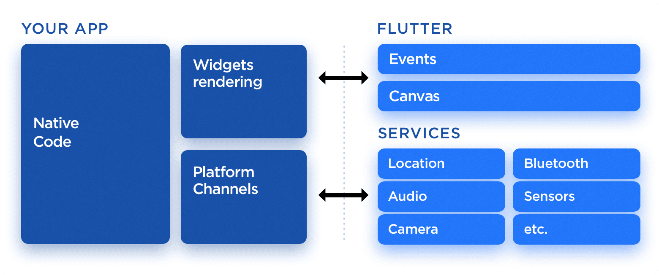
Mobile cross-platform development
Problem
Parallel development of Android and iOS is costly and time-consuming
The same interface on iOS and Android also brings inconveniences in the development process
Solution
Use Flutter to build a cross-platform app with a single code base

Slide 23
Learning with scripted video
Problem
Need to combine study & practice
Avoid too long lesson
Solution
Break the video lesson into parts, show exercise after each part.

Slide 24
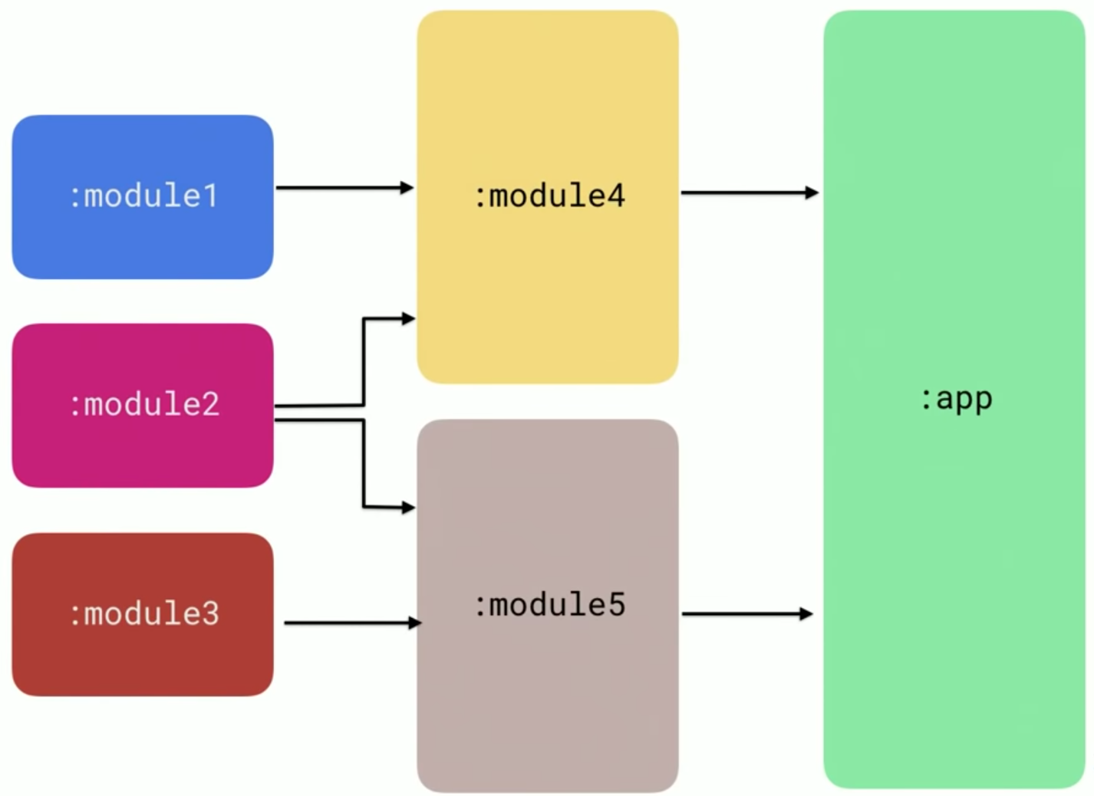
Modularize the app
Problem
Monolithic apps are usually tough to change or improve
Help us get rid of spaghetti code
Brings us the ability to reuse modules across different apps
Make team scaling easier

Slide 25
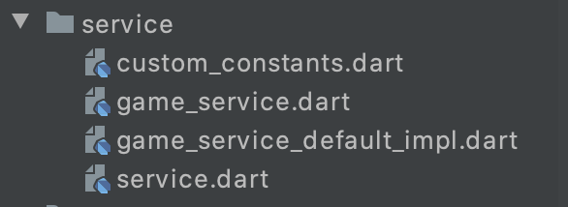
Modularize the app
Solution
Utilize the use of interface to delegate the implementation of logic in a module to the app containing that module
game_service.dart defines all the logic used in the module (load, navigate,...)
game_service_default_impl.dart is the default implementation
in the main app, init the service impl first
inject the implementation to the module by the singleton object defined in service.dart

Slide 26
05
Future work
Add more features such as more practice types, more constraints when taking the test,...
Improve app performance and error handling
Collect user behavior for course suggestions

Slide 27
THANK YOU

